Slide 1
MGMT 361 Operations Management
23. Supply Chain Coordination
Pengyi Shi
Notes:
Season 2, episode 18
Penny Blossoms production

Slide 2

Where we are …
Process Analysis
Process Variability
Quality Management
Inventory Management
Supply Chain Management
Notes:
Process Analysis: how can we improve a production or service process? How to assign jobs to equipment or workers?
So far, no variability, everything is on average
Variability and its impact on process performance: waiting times
Quality Management – how to detect quality issues and to control the quality?
Inventory management – how many units to keep in inventory
Production planning – how many units to produce or order
Supply chain management – how do parties in a SC interact

Slide 3
Supply Chain Management
Multiple activities/organizations involved in producing and delivering a good or service
The entire SC can be owned by one firm: centralized
The SC can also have multiple firms, and each firm makes decisions to maximize its own profit: decentralized
Manufacturer
Distributor
Wholesaler
Retailer
Consumer
Notes:
Beer game

Slide 4
Today’s Class
Incentive conflicts in decentralized supply chains
How to coordinate a decentralized supply chain
Notes:
Incentive conflicts that can occur in the absence of the bullwhip effect

Slide 5
Incentive Conflicts
Suboptimal performance due to double marginalization - each firm makes decisions based on its own margin
Supply chain performance can be significantly improved…
All parties (manufacturer, retailer, consumer) can be much better off if decision making is centralized

Slide 6


Example: Purdue Apparel Supply Chain
Two parties:
College Apparel (CA) produces authentic Purdue apparels
Purdue Store (PS) retails them
College Apparel
(supplier)
Purdue Store
(retailer)

Slide 7
Purdue Apparel Supply Chain – Centralized
College Apparel (CA) produces one jersey for C = $50.
Purdue Store (PS) retails them for R = $125 and “disposes” them for V = $25 (e.g., post-season sale).
Supply chain’s best decision: suppose CA and PS are owned by one company
How much should the SC order: Newsvendor problem
Excess cost (“leftover cost”):
Shortage cost (“profit”):
Critical ratio:
Notes:
Supply chain optimal quantity because it is the quantity that maximizes the integrated supply chain

Slide 8
Purdue Apparel Supply Chain – Centralized
Critical ratio = 75%, and the supply chain will produce Q=300
Demand (D) | Pr(D) | Sales =Min(D,300) | Sales * Pr(D)
100 | 25% | 100 | 25
200 | 25% | 200 | 50
300 | 25% | 300 | 75
400 | 25% | 300 | 75
Expected demand = 250
Expected sales = 225
Expected leftover inventory = 300 – 225 = 75
Supply chain’s profit =

Slide 9
Purdue Apparel Supply Chain – Decentralized
College Apparel (CA) and Purdue Store (PS) are two separate companies:
CA produces jerseys for C = $50 each and sells them to PS for W = $75 (wholesale price)
PS retails them for R = $125 and disposes them for V = $25.
How much should Purdue Store order?
Excess cost:
Shortage cost:
Critical ratio:

Slide 10
Purdue Apparel Supply Chain – Decentralized
Purdue Store’s Profit
Purdue Store (PS) has critical ratio 50% and orders Q=200 from College Apparel
Demand (D) | Pr(D) | Sales =Min(D,200) | Sales * Pr(D)
100 | 25% | 100 | 25
200 | 25% | 200 | 50
300 | 25% | 200 | 50
400 | 25% | 200 | 50
Expected demand = 250
Expected sales = 175
Expected leftover inventory = 25
PS’s expected profit =

Slide 11
Purdue Apparel Supply Chain – Decentralized
College Apparel’s profit
CA produces Q = 200 at a margin $75 - $50 = $25
CA’s Profit =
Total supply chain profit =

Slide 12
Purdue Apparel Supply Chain – Centralized
College Apparel (CA) produces one jersey for C = $50.
Purdue Store (PS) retails them for R = $125 and “disposes” them for V = $25 (e.g., post-season sale).
Supply chain’s best decision: suppose CA and PS are owned by one company
How much should the SC order: Newsvendor problem
Excess cost (“leftover cost”): C_{e} = C – V = 50 – 25 = 25
Shortage cost (“profit”): C_{s} = R – C = 125 – 50 = 75
Critical ratio: 75/(25+75) = 75%
Notes:
Supply chain optimal quantity because it is the quantity that maximizes the integrated supply chain

Slide 13
Purdue Apparel Supply Chain – Centralized
Critical ratio = 75%, and the supply chain will produce Q=300
Demand (D) | Pr(D) | CDF | Sales =Min(D,300) | Sales * Pr(D)
100 | 25% | 0.25 | 100 | 100*0.25=25
200 | 25% | 0.50 | 200 | 200*0.25=50
300 | 25% | 0.75 | 300 | 300*0.25=75
400 | 25% | 1 | 300 | 300*0.25=75
Expected demand = 250
Expected sales = 225
Expected leftover inventory = Q- E[sales]= 300 – 225 = 75
Supply chain’s profit = E[sale]*(R-C) – E[leftover]*(C-V)
= 225 * (125 – 50) – 75 * (50 – 25) = $15,000

Slide 14
Purdue Apparel Supply Chain – Decentralized
College Apparel (CA) and Purdue Store (PS) are two separate companies:
CA produces jerseys for C = $50 each and sells them to PS for W = $75 (wholesale price)
PS retails them for R = $125 and disposes them for V = $25.
How much should Purdue Store order?
Excess cost: Ce = 75 – 25 = 50
Shortage cost: Cs = 125 – 75 = 50
Critical ratio: 50/(50+50) = 50%

Slide 15
Purdue Apparel Supply Chain – Decentralized
Purdue Store’s Profit
Purdue Store (PS) has critical ratio 50% and orders Q=200 from College Apparel
Demand (D) | Pr(D) | CDF | Sales =Min(D,200) | Sales * Pr(D)
100 | 25% | 0.25 | 100 | 25
200 | 25% | 0.50 | 200 | 50
300 | 25% | 0.75 | 200 | 50
400 | 25% | 1 | 200 | 50
Expected demand = 250
Expected sales = 175
Expected leftover inventory = 25
PS’s expected profit =E[sale]*(R-C) – E[leftover]*(C-V)
= 175 * (125 – 75) – 25 * (75 – 25) = $7,500

Slide 16
Purdue Apparel Supply Chain – Decentralized
College Apparel’s profit
CA produces Q = 200 at a margin = W – C = $75 - $50 = $25
CA’s Profit = 25 * 200 = $5,000
Total supply chain profit = $7,500 (previous slide) + $5,000 = $12,500 < $15,000 (centralized case)

Slide 17
Purdue Apparel Supply Chain – Observations
 | Centralized | Decentralized
Shortage Cost | 125 – 50 = 75 | 125 – 75 = 50
Excess Cost | 50 – 25 = 25 | 75 – 25 = 50
Critical Ratio | 75% | 50%
Order | 300 | 200
Expected sales | 225 | 175
Expected leftover | 75 | 25
SC Expected profit | $15,000 | $12,500
Notes:
Why Purdue Store doesn’t order enough? It acts in its own self-interest to maximize its own profit
Incentive conflict

Slide 18
Incentive Conflicts
Suboptimal supply chain performance occurs due to double marginalization
Retailer in the decentralized SC has lower shortage and higher excess cost ➔ lower critical ratio ➔ smaller order quantity ➔ lower service level
The SC’s profit (retailer and supplier combined) is lower than the highest possible
Notes:
Double marginalization; Purdue Store margin is less than the total margin of the supply chain
Even if every firm in a supply chain chooses actions to maximize its own expected profit, the total profit earned in the supply chain may be less than the entire supply chain’s maximum profit.
Marginal cost pricing

Slide 19
Supply Chain Coordination
Align incentives to achieve optimal SC performance
Key questions:
How to achieve the centralized profit –make the retailer order the optimal quantity for the centralized supply chain?
How to split the benefit and make sure everyone is willing to coordinate?
Buy-back contract
Notes:
How maximize the size of a firm’s piece of the “pie” (supply chain’s total profit) & the size of the total “pie” at the same time
Buy-back contract is a tool that first max the size of the pie and then allows the firms to decide how to divide it between them without damaging any part of it.

Slide 20
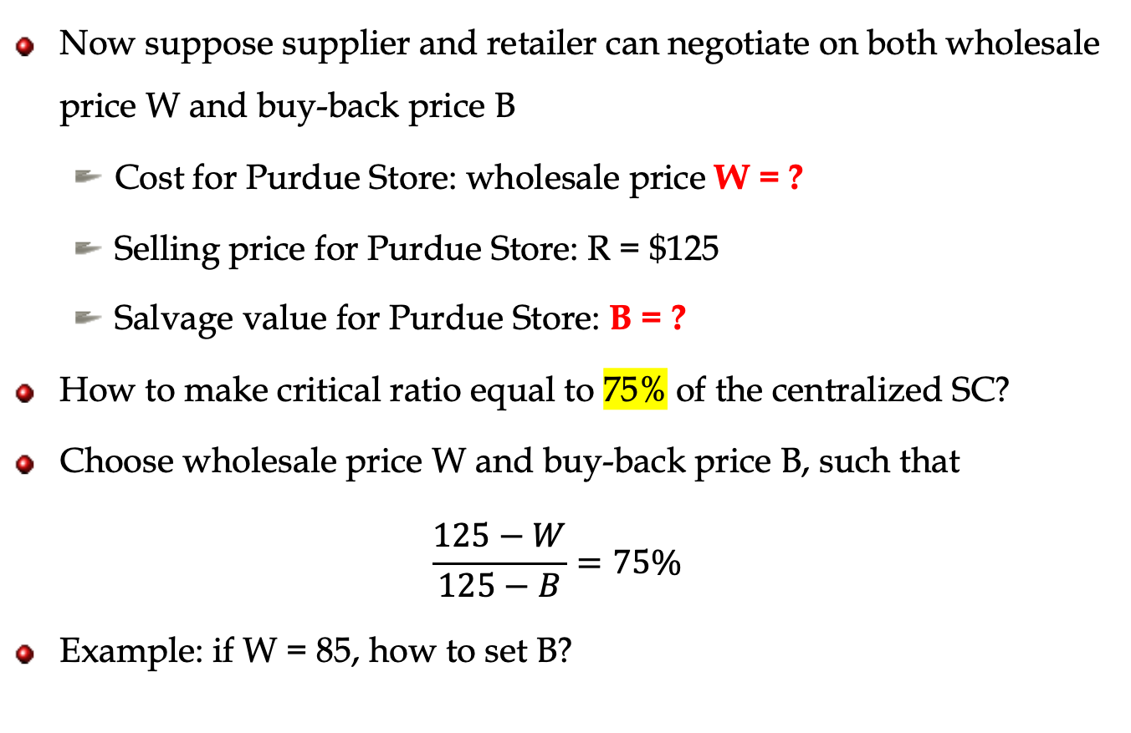
Supply Chain Coordination by Buy-Back Contract
Now suppose supplier and retailer can negotiate on both wholesale price W and buy-back price B
Cost for Purdue Store: wholesale price W = ?
Selling price for Purdue Store: R = $125
Salvage value for Purdue Store: B = ?
How to make critical ratio equal to 75% of the centralized SC?
Choose wholesale price W and buy-back price B, such that
$$\frac{125−W}{125−B}=75\%$$
Example: if W = 85, how to set B?
Notes:
100% supply chain efficiency

Slide 21
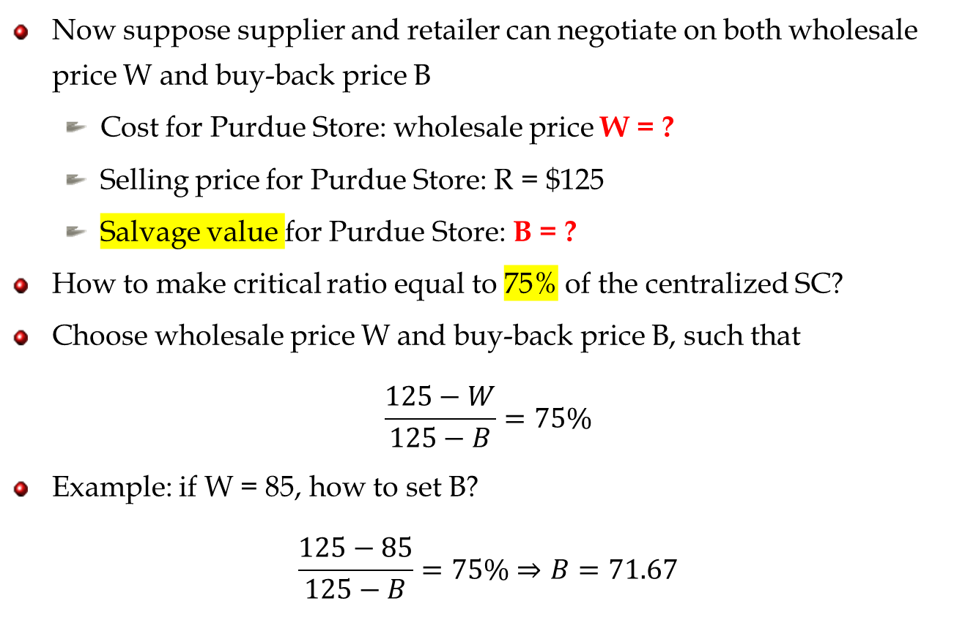
Supply Chain Coordination by Buy-Back Contract
Now suppose supplier and retailer can negotiate on both wholesale price W and buy-back price B
Cost for Purdue Store: wholesale price W = ?
Selling price for Purdue Store: R = $125
Salvage value for Purdue Store: B = ?
How to make critical ratio equal to 75% of the centralized SC?
Choose wholesale price W and buy-back price B, such that
$$\frac{125−W}{125−B}=75\%$$
Example: if W = 85, how to set B?
$$\frac{125−85}{125−B}=75\%⇒B=71.67$$
Notes:
100% supply chain efficiency

Slide 22
In-class Exercise: Calculate Purdue Store’s Profit
W = 85, B = 71.67
Purdue Store’s optimal order quantity? Q=300
Recall E[sold] = 225, E[leftover] = 75
Revenue from 225 units expected sales:
Excess cost from 75 units expected leftovers:
Purdue Store’s (retailor) profit =
 | Centralized SC | Purdue Store
Excess cost | 50 – 25 = 25 | 85-71.67=13.33
Shortage cost | 125 – 50 = 75 | 125-85=40
Critical ratio | 75% | 75%

Slide 23
In-class Exercise: Calculate College Apparel’s Profit
When W = 85, B = 71.67
Revenue from selling 300 units:
Buy-back cost for 75 units expected leftovers:
Salvage value (from College Apparel’s liquidates):
College Apparel’s (supplier) profit =

Slide 24
Calculate Purdue Store’s Profit
W = 85, B = 71.67
Purdue Store’s optimal order quantity?
Recall E[sales] = 225, E[leftover] = 75
Revenue from 225 units expected sales: (R-W)*E[sales] = (125-85)*225 = 9,000
Excess cost from 75 units expected leftovers: (W-B)*E[leftover]= (85-71.67) * 75 = 1000
Purdue Store’s profit = 9,000 – 1000 = 8000
 | Centralized SC | Purdue Store
Excess cost | 50 – 25 = 25 | 85-71.67=13.33
Shortage cost | 125 – 50 = 75 | 125-85=40
Critical ratio | 75% | 75%

Slide 25
Calculate College Apparel’s Profit
When W = 85, B = 71.67
Revenue from selling 300 units: (W-C)*Q = (85-50)*300 = 10,500
Buy-back cost for 75 units expected leftovers: B*E[leftover] = 71.67 * 75 = 5,375
Salvage value (from College Apparel’s liquidates): V*E[leftover] = 25 * 75 = 1,875
College Apparel’s profit = 10500 - 5375 + 1875 = 7000

Slide 26
Supply Chain Coordination
Achieves optimal supply chain profit
All parties are better off
Supplier and retailer: higher profit, willing to participate
Consumers: more inventory, higher service level

Slide 27
Summary
Incentive conflict in decentralized supply chains
Double marginalization: each firm acts based on its own margin
Suboptimal supply chain performance
Supply chain coordination: Buy-back contract
Contract terms
How does it coordinate the SC
Calculate wholesale price or buy-back price
Profit calculation

Slide 29
Buy-Back Contracts
How do they improve supply chain performance?
The supplier shares the risk (excess cost) of left over inventory with the retailer
The retailer’s excess cost is reduced, so the retailer is willing to stock more
What are the costs of buy-back contracts?
Administrative costs plus additional shipping and handling costs.
Where are they used?
books, cosmetics, music CDs, agricultural chemicals, electronic

Slide 30
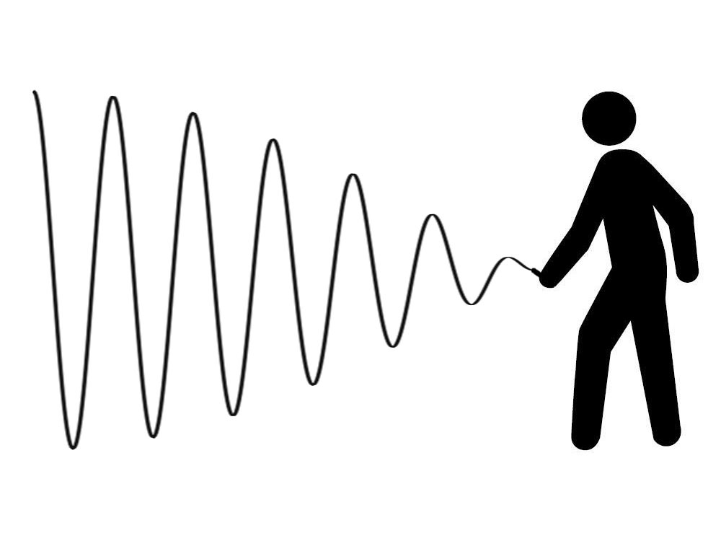
Recap: Bullwhip Effect
Demand/order variation gets amplified as one goes upstream in the supply chain
Brewery
Distributor
Wholesaler
Retailer
Consumer
Notes:
Bulwhip effect deteriorates supply chain performance by propagating demand variability up the supply chain
But optimal supply chain performance is also not guaranteed in the absence of the bullwhip effect

Slide 31
Decentralized SC with Buy-Back Contract
At the end of the selling season, college apparel will buy back unsold jerseys at a pre-determined price of $45 each.
Cost for Purdue Store: wholesale price W = $75
Selling price for Purdue Store: R = $125
Salvage value for Purdue Store: B = $45
Purdue Store’s critical ratio under the buy-back contract:
Notes:
Returns policy

